Slide 1

GAME TITLE
JOIN GAME
CREATE GAME
SETTINGS
QUIT

Slide 2

JOIN GAME
GAME ID
JYQTS
REGION
EUROPE
NEXT

Slide 3


CHOOSE YOUR CHARACTER
NICKNAME
MIKE
START GAME

Slide 4
CREATE YOUR GAME
UNIQUE GAME ID
JYQTS
MAX PLAYERS
10
REGION
EUROPE
NEXT

Slide 5
SETTINGS
SELECT LANGUAGE
English
SOUNDS
OFF
DEFAULT REGION
EUROPE
BACK

Slide 6
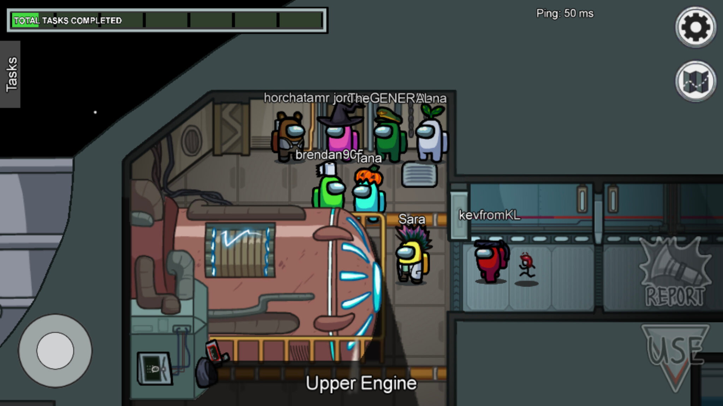

Slide 7

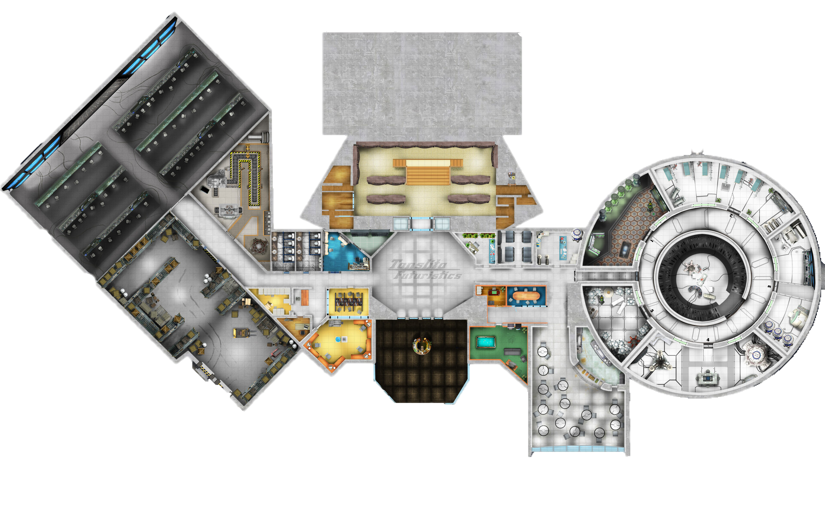

Slide 8
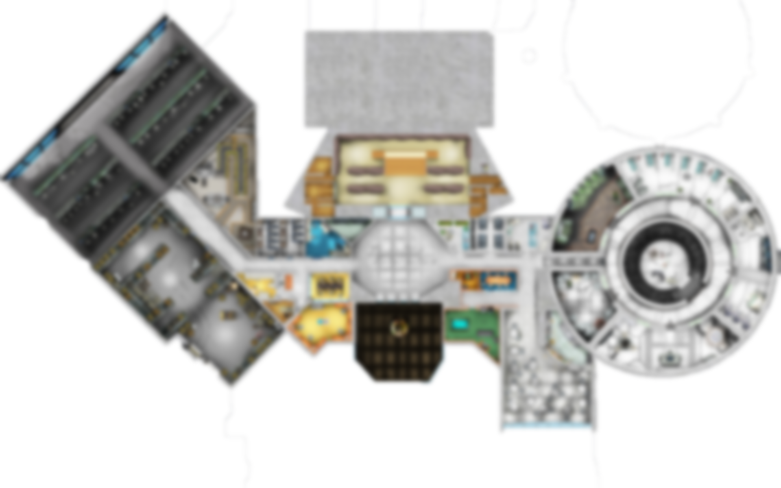
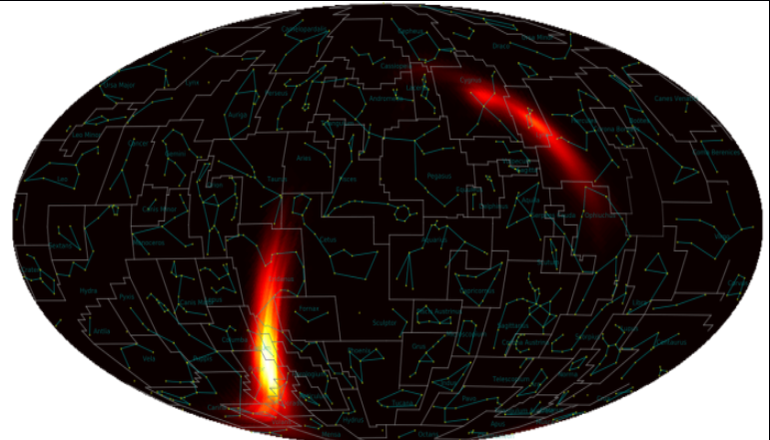
MATCH THE EVENT TO THE IMAGE
GW19092
GW87202
GW92354

Slide 9

MATCH THE EVENT TO THE IMAGE
CORRECT
GW19092
GW87202
GW92354

Slide 10
GAME ENDED
YOU WIN
Congrats you finished
all the tasks first.
EXIT

